Slide 1
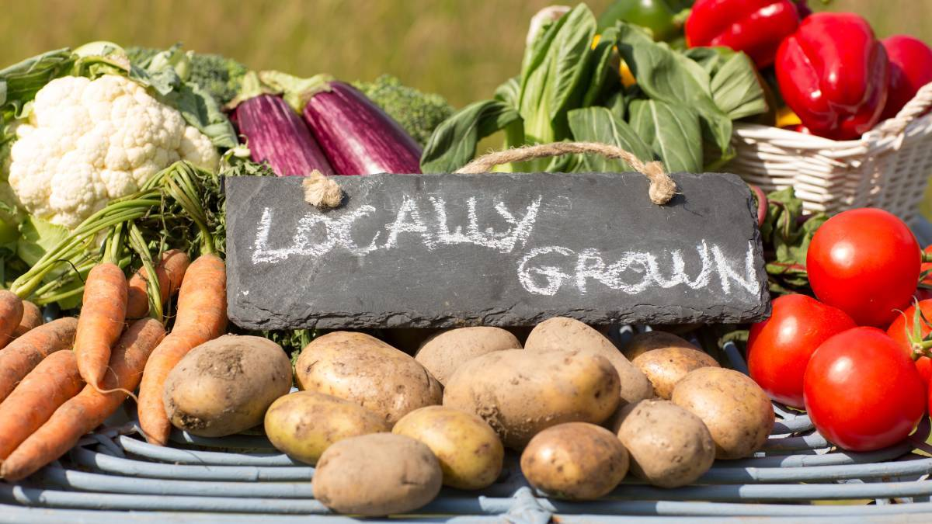
Friday
10am – 1pm
Northern Suburbs
Community Centre
49 George Town Road
Newnham
The FaRM Garden Gate Sale
Fresh veggies taken straight from the garden to you!

